Slide 1
MICROPROCESSOR
ARCHITECTURE

Slide 2
Presentation Outline
Basic Computer Organization
Intel Microprocessors
IA-32 Registers
Instruction Execution Cycle
IA-32 Memory Management

Slide 3
Basic Computer Organization
Since the 1940's, computers have 3 classic components:
Processor, called also the CPU (Central Processing Unit)
Memory and Storage Devices
I/O Devices
Interconnected with one or more buses
Bus consists of
Data Bus
Address Bus
Control Bus
data bus
registers
Processor
(CPU)
Memory
I/O
I/O
Device
Device
#1
#2
ALU
CU
clock
control bus
address bus

Slide 4
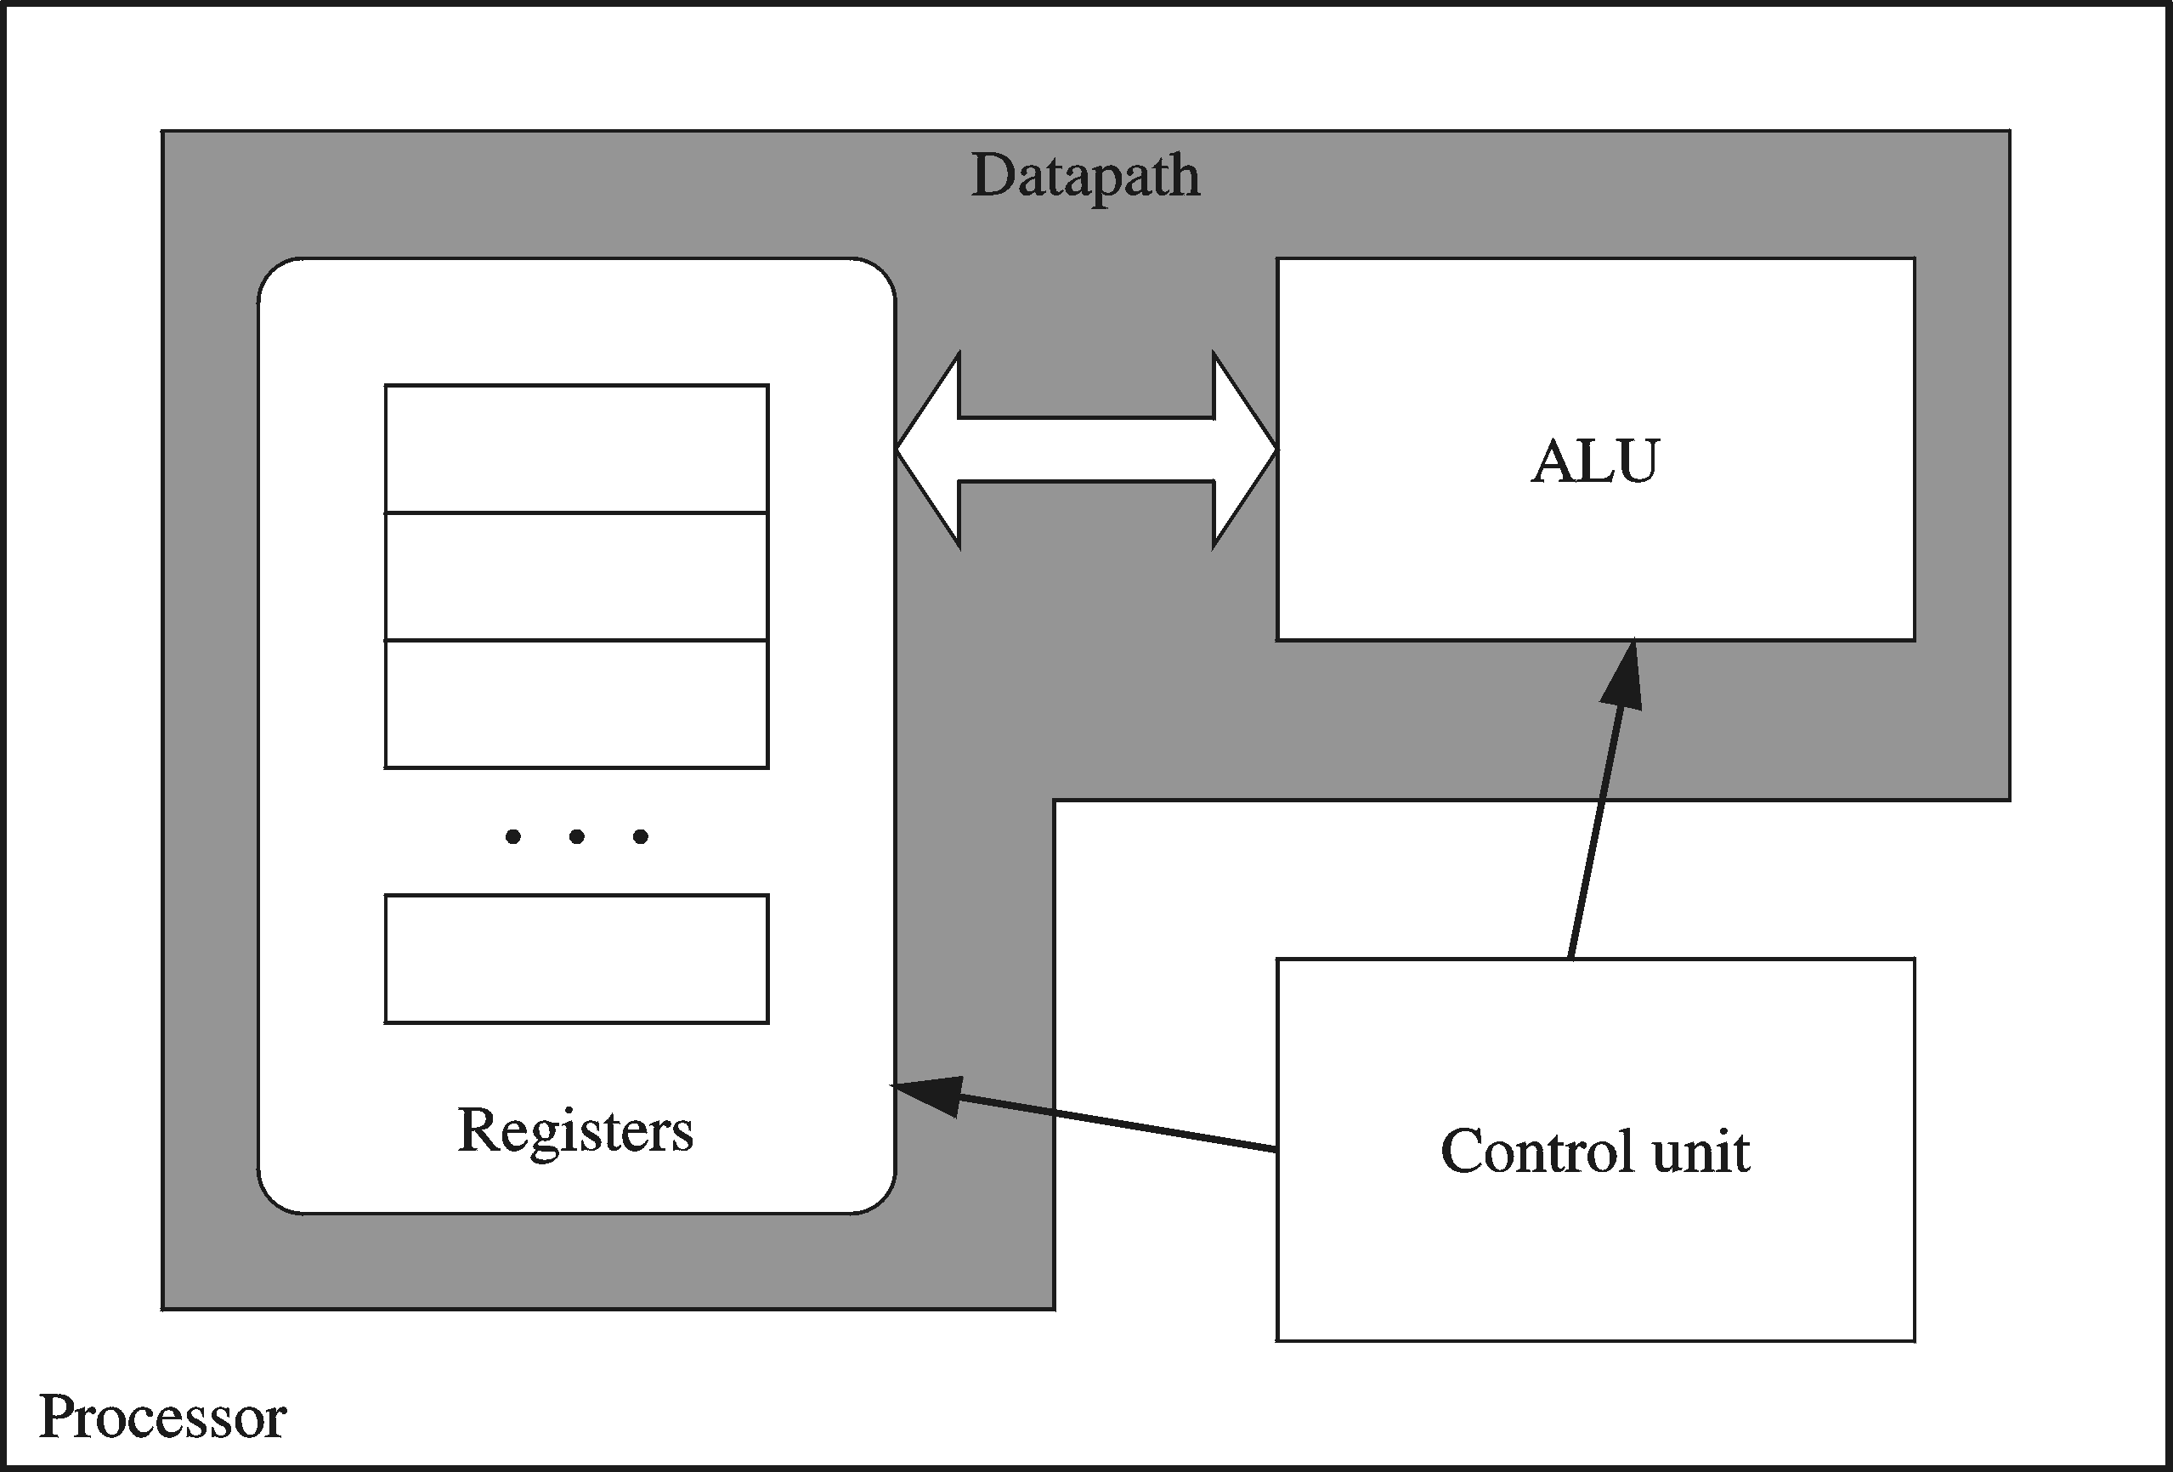
Processor
Processor consists of
Datapath
ALU
Registers
Control unit
ALU
Performs arithmetic
and logic instructions
Control unit (CU)
Generates the control signals required to execute instructions
Implementation varies from one processor to another

Slide 5
Clock
Synchronizes Processor and Bus operations
Clock cycle = Clock period = 1 / Clock rate
Clock rate = Clock frequency = Cycles per second
1 Hz = 1 cycle/sec 1 KHz = 10³ cycles/sec
1 MHz = 10⁶ cycles/sec 1 GHz = 10⁹ cycles/sec
2 GHz clock has a cycle time = 1/(2×10⁹) = 0.5 nanosecond (ns)
Clock cycles measure the execution of instructions
Cycle 1
Cycle 2
Cycle 3

Slide 6
Memory
Ordered sequence of bytes
The sequence number is called the memory address
Byte addressable memory
Each byte has a unique address
Supported by almost all processors
Physical address space (NOTE PLEASE)
Determined by the address bus width
Pentium has a 32-bit address bus
Physical address space = 4GB = 2³² bytes
Itanium with a 64-bit address bus can support
Up to 2⁶⁴ bytes of physical address space

Slide 7
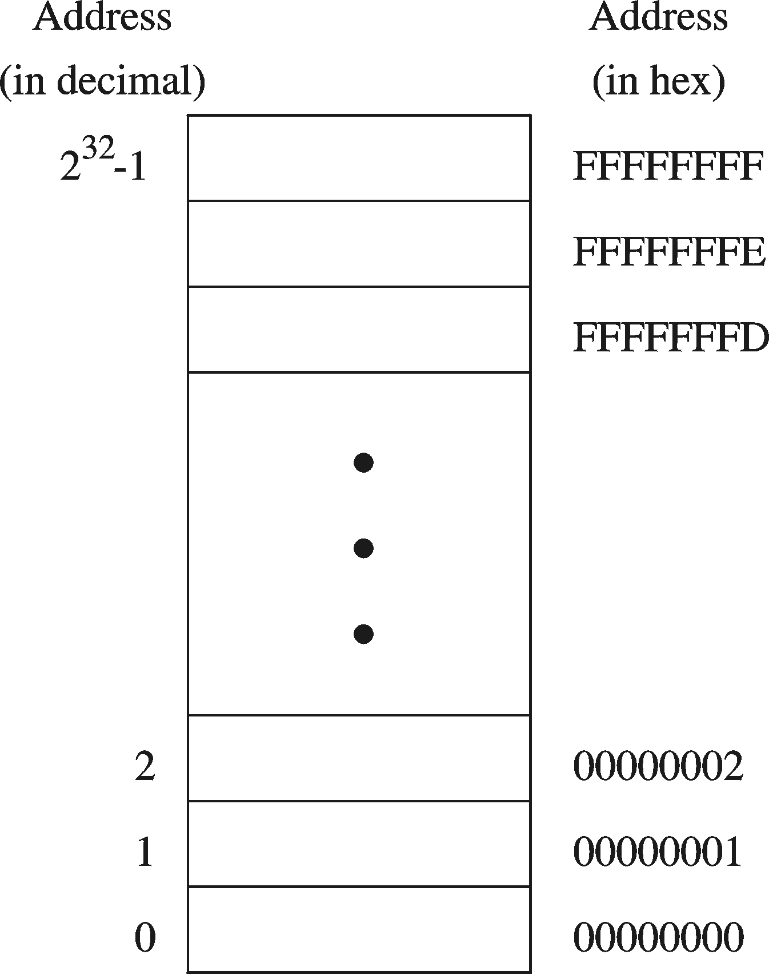
Address Space
Address Space is the set of memory locations (bytes) that can be addressed

Slide 8
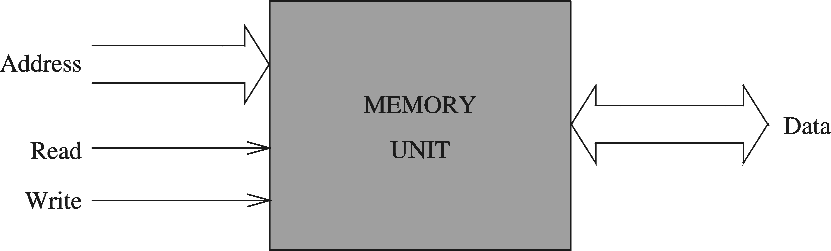
Memory Unit
Address Bus
Address is placed on the address bus
Address of location to be read/written
Data Bus
Data is placed on the data bus
Two Control Signals
Read
Write
Control whether memory should be read or written

Slide 9
Memory Read and Write Cycles
Read cycle
1. Processor places address on the address bus
2. Processor asserts the memory read control signal
3. Processor waits for memory to place the data on the data bus
4. Processor reads the data from the data bus
Processor drops the memory read signal
Write cycle
1. Processor places address on the address bus
Processor asserts the memory write control signal
Processor places the data on the data bus
Wait for memory to store the data (wait states for slow memory)
5. Processor drops the memory write signal

Slide 10
Reading from Memory
Multiple clock cycles are required
Memory responds much more slowly than the CPU
Address is placed on address bus
Read Line (RD) goes low, indicating that processor wants to read
CPU waits (one or more cycles) for memory to respond
Read Line (RD) goes high, indicating that data is on the data bus

Slide 11
Memory Devices
ROM = Read-Only Memory
Stores information permanently (non-volatile)
Used to store the information required to startup the computer
Many types: ROM, EPROM, EEPROM, and FLASH
FLASH memory can be erased electrically in blocks
RAM = Random Access Memory
Volatile memory: data is lost when device is powered off
Dynamic RAM (DRAM)
Inexpensive, used for main memory, must be refreshed constantly
Static RAM (SRAM)
Expensive, used for cache memory, faster access, no refresh
Video RAM (VRAM)
Dual ported: read port to refresh the display, write port for updates

Slide 12
Assignment 2 A
Write out the full meaning of the following while writing notes on them
ROM
EPROM
EEPROM

Slide 13
Memory Hierarchy
Registers
Fastest storage elements, stores most frequently used data
General-purpose registers: accessible to the programmer
Special-purpose registers: used internally by the microprocessor
Cache Memory
Fast SRAM that stores recently used instructions and data
Recent processors have 2 levels
Main Memory (DRAM)
Disk Storage
Permanent magnetic
storage for files
registers
cache memory
higher speed, smaller size
lower cost per byte
main memory
disk storage

Slide 14
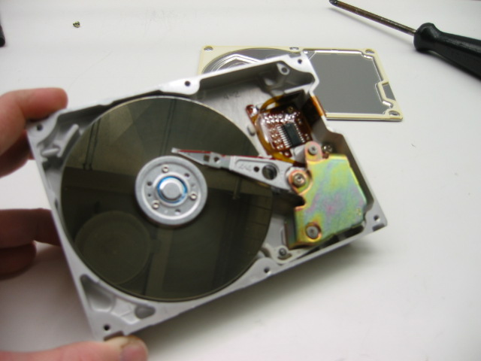
Magnetic Disk Storage
Sector
Read/write head
Actuator
Recording area
Track 2
Track 1
Track 0
Arm
Direction of rotation
Platter
Spindle
Disk Access Time =
Seek Time +
Rotation Latency +
Transfer Time
Seek Time: head movement to the desired track (milliseconds)
Rotation Latency: disk rotation until desired sector arrives under the head
Transfer Time: to transfer one sector

Slide 15
Example on Disk Access Time
Given a magnetic disk with the following properties
Rotation speed = 7200 RPM (rotations per minute)
Average seek = 8 ms, Sector = 512 bytes, Track = 200 sectors
Calculate
Time of one rotation (in milliseconds)
Average time to access a block of 32 consecutive sectors
Answer
Rotations per second
Rotation time in milliseconds
Average rotational latency
Time to transfer 32 sectors
Average access time
= 7200/60 = 120 RPS
= 1000/120 = 8.33 ms
= time of half rotation = 4.17 ms
= (32/200) * 8.33 = 1.33 ms
= 8 + 4.17 + 1.33 = 13.5 ms

Slide 16
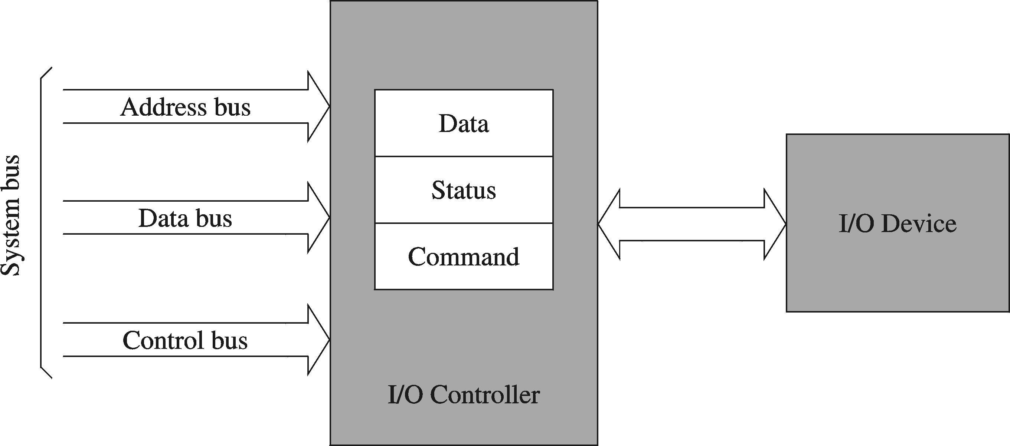
I/O Controllers
I/O devices are interfaced via an I/O controller
I/O controller uses the system bus to communicate with processor
I/O controller takes care of low-level operation details

Slide 17
Next ...
Basic Computer Organization
Intel Microprocessors
IA-32 Registers
Instruction Execution Cycle
IA-32 Memory Management

Slide 18
Intel Microprocessors
Intel introduced the 8086 microprocessor in 1979
8086, 8087, 8088, and 80186 processors
16-bit processors with 16-bit registers
16-bit data bus and 20-bit address bus
Physical address space = 2²⁰ bytes = 1 MB
8087 Floating-Point co-processor
Uses segmentation and real-address mode to address memory
Each segment can address 2¹⁶ bytes = 64 KB
8088 is a less expensive version of 8086
Uses an 8-bit data bus
80186 is a faster version of 8086

Slide 19
Intel 80286 and 80386 Processors
80286 was introduced in 1982
24-bit address bus ⇒ 2²⁴ bytes = 16 MB address space
Introduced protected mode
Segmentation in protected mode is different from the real mode
80386 was introduced in 1985
First 32-bit processor with 32-bit general-purpose registers
First processor to define the IA-32 architecture
32-bit data bus and 32-bit address bus
2³² bytes ⇒ 4 GB address space
Introduced paging, virtual memory, and the flat memory model
Segmentation can be turned off

Slide 20
Assignment 2B
Write extensively on the following
➔Paging
➔virtual memory
➔flat memory model
➔ Pipelining

Slide 21
Intel 80486 and Pentium Processors
80486 was Introduced 1989
Improved version of Intel 80386
On-chip Floating-Point unit (DX versions)
On-chip unified Instruction/Data Cache (8 KB)
Uses Pipelining: can execute up to 1 instruction per clock cycle
Pentium (80586) was introduced in 1993
Wider 64-bit data bus, but address bus is still 32 bits
Two execution pipelines: U-pipe and V-pipe
Superscalar performance: can execute 2 instructions per clock cycle
Separate 8 KB instruction and 8 KB data caches
MMX instructions (later models) for multimedia applications

Slide 22
Intel P6 Processor Family
P6 Processor Family: Pentium Pro, Pentium II and III
Pentium Pro was introduced in 1995
Three-way superscalar: can execute 3 instructions per clock cycle
36-bit address bus ⇒ up to 64 GB of physical address space
Introduced dynamic execution
Out-of-order and speculative execution
Integrates a 256 KB second level L2 cache on-chip
Pentium II was introduced in 1997
Added MMX instructions (already introduced on Pentium MMX)
Pentium III was introduced in 1999
Added SSE instructions and eight new 128-bit XMM registers

Slide 23
Pentium 4 and Xeon Family
Pentium 4 is a seventh-generation x86 architecture
Introduced in 2000
New micro-architecture design called Intel Netburst
Very deep instruction pipeline, scaling to very high frequencies
Introduced the SSE2 instruction set (extension to SSE)
Tuned for multimedia and operating on the 128-bit XMM registers
In 2002, Intel introduced Hyper-Threading technology
Allowed 2 programs to run simultaneously, sharing resources
Xeon is Intel's name for its server-class microprocessors
Xeon chips generally have more cache
Support larger multiprocessor configurations

Slide 24
Pentium-M and EM64T
Pentium M (Mobile) was introduced in 2003
Designed for low-power laptop computers
Modified version of Pentium III, optimized for power efficiency
Large second-level cache (2 MB on later models)
Runs at lower clock than Pentium 4, but with better performance
Extended Memory 64-bit Technology (EM64T)
Introduced in 2004
64-bit superset of the IA-32 processor architecture
64-bit general-purpose registers and integer support
Number of general-purpose registers increased from 8 to 16
64-bit pointers and flat virtual address space
Large physical address space: up to 2⁴⁰ = 1 Terabytes

Slide 25
CISC and RISC
CISC – Complex Instruction Set Computer
Large and complex instruction set
Variable width instructions
Requires microcode interpreter
Each instruction is decoded into a sequence of micro-operations
Example: Intel x86 family
RISC – Reduced Instruction Set Computer
Small and simple instruction set
All instructions have the same width
Simpler instruction formats and addressing modes
Decoded and executed directly by hardware
Examples: ARM, MIPS, PowerPC, SPARC, etc.

Slide 26
Next ...
Basic Computer Organization
Intel Microprocessors
IA-32 Registers
Instruction Execution Cycle
IA-32 Memory Management

Slide 27
Basic Program Execution Registers
Registers are high speed memory inside the CPU
Eight 32-bit general-purpose registers
Six 16-bit segment registers
Processor Status Flags (EFLAGS) and Instruction Pointer (EIP)
32-bit General-Purpose Registers
EAX
EBP
EBX
ESP
ECX
ESI
EDX
EDI
16-bit Segment Registers
EFLAGS
CS
ES
SS
FS
EIP
DS
GS

Slide 28
General-Purpose Registers
Used primarily for arithmetic and data movement
mov eax, 10 move constant 10 into register eax
Specialized uses of Registers
EAX – Accumulator register
Automatically used by multiplication and division instructions
ECX – Counter register
Automatically used by LOOP instructions
ESP – Stack Pointer register
Used by PUSH and POP instructions, points to top of stack
ESI and EDI – Source Index and Destination Index register
Used by string instructions
EBP – Base Pointer register
Used to reference parameters and local variables on the stack

Slide 29
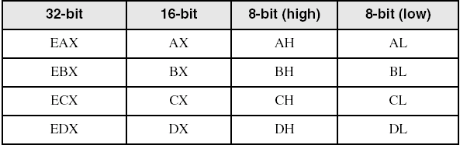
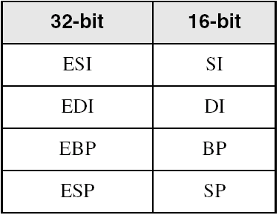
Accessing Parts of Registers
EAX, EBX, ECX, and EDX are 32-bit Extended registers
Programmers can access their 16-bit and 8-bit parts
Lower 16-bit of EAX is named AX
AX is further divided into
AL = lower 8 bits
AH = upper 8 bits
ESI, EDI, EBP, ESP have only
16-bit names for lower half

Slide 30
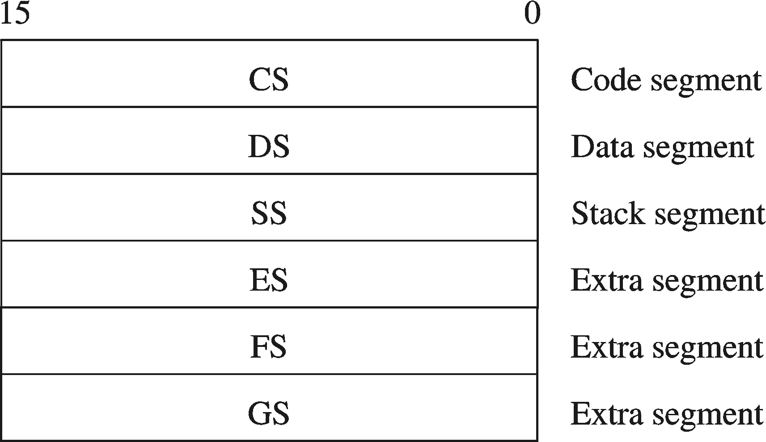
Special-Purpose & Segment Registers
EIP = Extended Instruction Pointer
Contains address of next instruction to be executed
EFLAGS = Extended Flags Register
Contains status and control flags
Each flag is a single binary bit
Six 16-bit Segment Registers
Support segmented memory
Six segments accessible at a time
Segments contain distinct contents
Code
Data
Stack

Slide 31
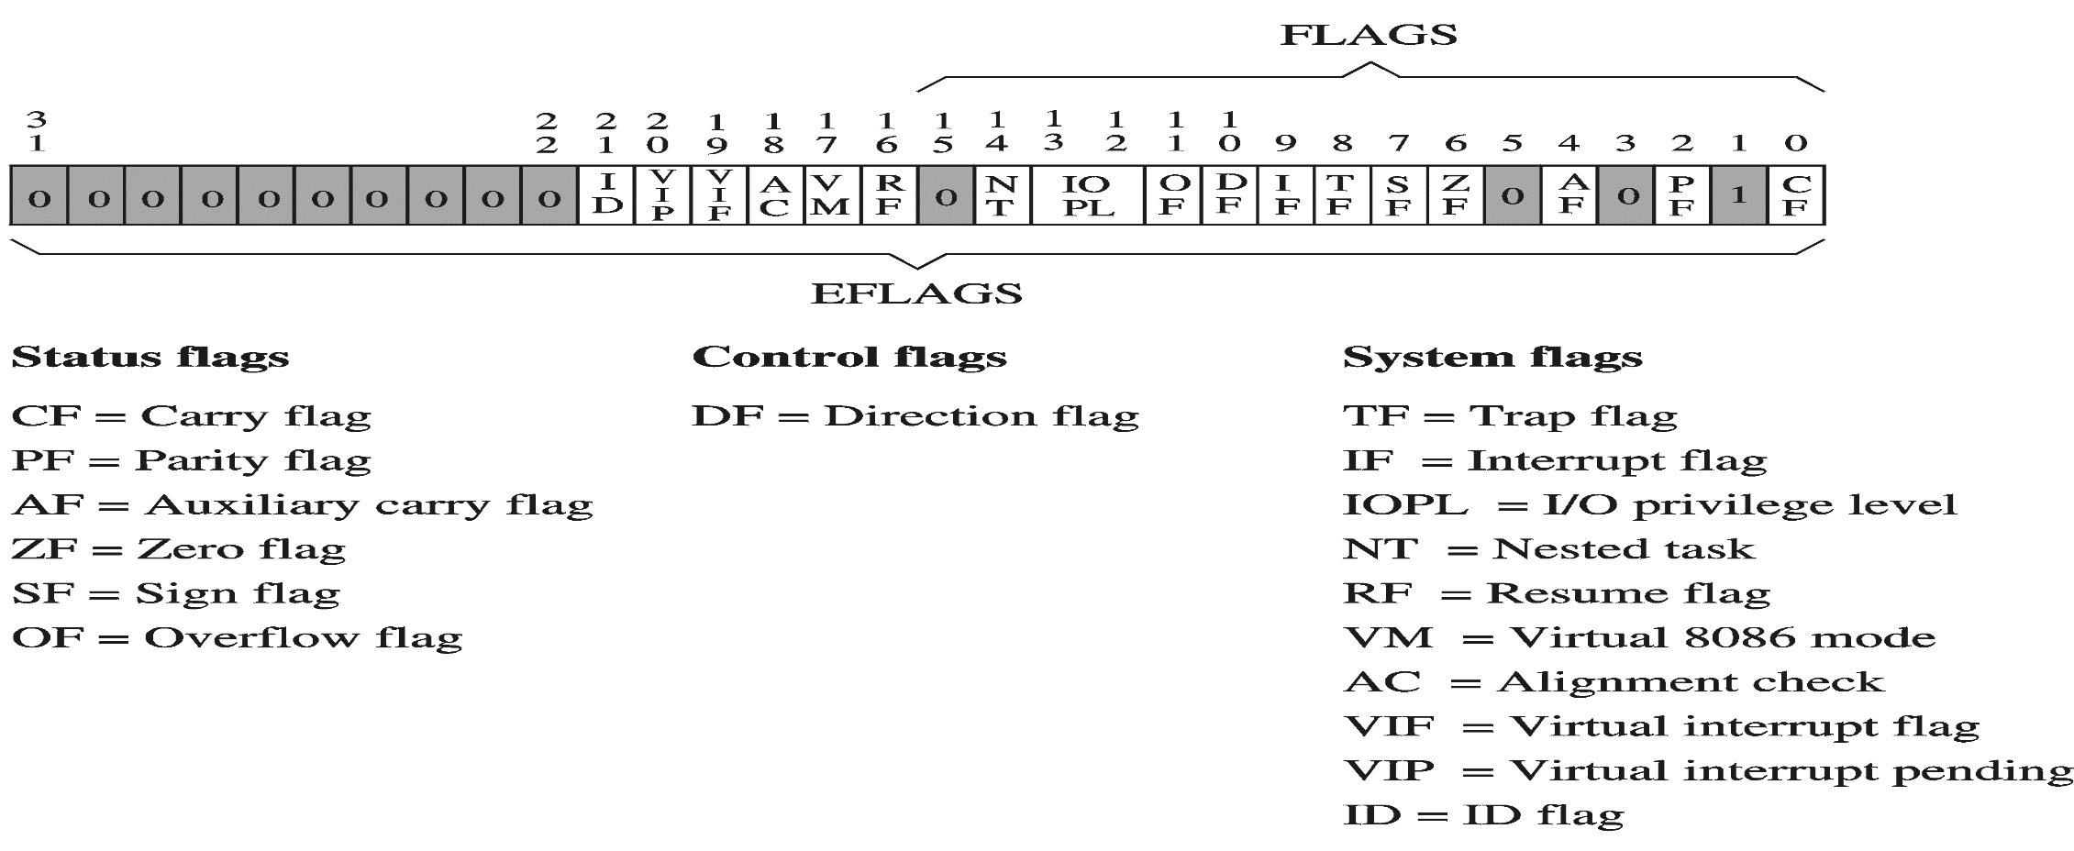
EFLAGS Register
Status Flags
Status of arithmetic and logical operations
Control and System flags
Control the CPU operation
Programs can set and clear individual bits in the EFLAGS register

Slide 32
Status Flags
Carry Flag
Set when unsigned arithmetic result is out of range
Overflow Flag
Set when signed arithmetic result is out of range
Sign Flag
Copy of sign bit, set when result is negative
Zero Flag
Set when result is zero
Auxiliary Carry Flag
Set when there is a carry from bit 3 to bit 4
Parity Flag
Set when parity is even
Least-significant byte in result contains even number of 1s

Slide 33
Floating-Point, MMX, XMM Registers
Floating-point unit performs high speed FP operations
Eight 80-bit floating-point data registers
ST(0), ST(1), . . . , ST(7)
Arranged as a stack
Used for floating-point arithmetic
Eight 64-bit MMX registers
Used with MMX instructions
Eight 128-bit XMM registers
Used with SSE instructions

Slide 34
Next ...
Basic Computer Organization
Intel Microprocessors
IA-32 Registers
Instruction Execution Cycle
IA-32 Memory Management

Slide 35
Instruction Execute Cycle
Instruction
Fetch
Obtain instruction from program storage
Instruction
Decode
Determine required actions and instruction size
Operand
Fetch
Infinite Cycle
Locate and obtain operand data
Execute
Compute result value and status
Writeback
Result
Deposit results in storage for later use

Slide 36
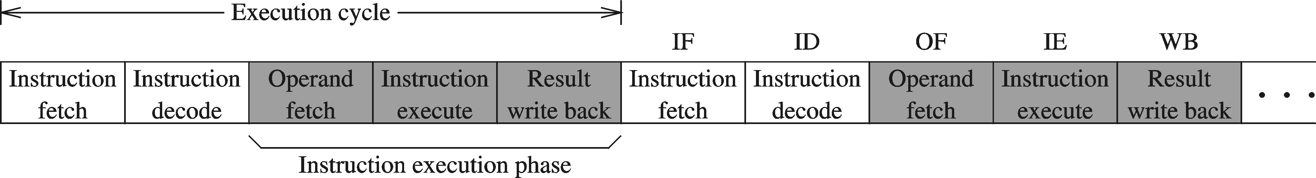
Instruction Execution Cycle – cont'd
Instruction Fetch
Instruction Decode
Operand Fetch
Execute
Result Writeback
PC
program
I1
I2
I3
I4
. . .
memory
fetch
op1
read
op2
registers
registers
I1
instruction
register
decode
write
write
flags
ALU
execute
(output)

Slide 37
Pipelined Execution
Instruction execution can be divided into stages
Pipelining makes it possible to start an instruction before completing the execution of previous one
Stages
For k stages and n instructions, the number of required cycles is: k + n – 1
S1
S2
S3
S4
S5
S6
1
I-1
2
I-1
3
I-1
4
I-1
5
I-1
Cycles
6
Non-pipelined execution
Wasted clock cycles
I-1
7
I-2
8
I-2
9
I-2
Pipelined
Execution
10
I-2
11
I-2
12
I-2

Slide 38
Wasted Cycles (pipelined)
When one of the stages requires two or more clock cycles to complete, clock cycles are again wasted
Assume that stage S4 is the execute stage
Assume also that S4 requires 2 clock cycles to complete
As more instructions enter the pipeline, wasted cycles occur
For k stages, where one stage requires 2 cycles, n instructions require k + 2n – 1 cycles
Stages
exe
S1
S2
S3
S4
S5
S6
1
I-1
2
I-2
I-1
3
I-3
I-2
I-1
4
I-3
I-2
I-1
Cycles
5
I-3
I-1
6
I-2
I-1
7
I-2
I-1
8
I-3
I-2
9
I-3
I-2
10
I-3
11
I-3

Slide 39
Superscalar Architecture
A superscalar processor has multiple execution pipelines
The Pentium processor has two execution pipelines
Called U and V pipes
In the following, stage
S4 has 2 pipelines
Each pipeline still
requires 2 cycles
Second pipeline
eliminates wasted cycles
For k stages and n
instructions, number of
cycles = k + n

Slide 40
Next ...
Basic Computer Organization
Intel Microprocessors
IA-32 Registers
Instruction Execution Cycle
IA-32 Memory Management

Slide 41
Modes of Operation
Real-Address mode (original mode provided by 8086)
Only 1 MB of memory can be addressed, from 0 to FFFFF (hex)
Programs can access any part of main memory
MS-DOS runs in real-address mode
Protected mode (introduced with the 80386 processor)
Each program can address a maximum of 4 GB of memory
The operating system assigns memory to each running program
Programs are prevented from accessing each other’s memory
Native mode used by Windows NT, 2000, XP, and Linux
Virtual 8086 mode
Processor runs in protected mode, and creates a virtual 8086 machine with 1 MB of address space for each running program

Slide 42
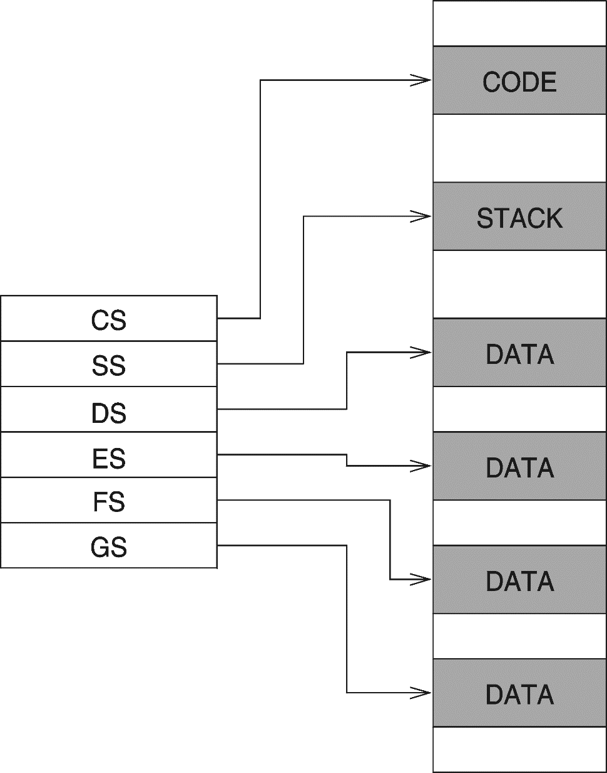
Real Address Mode
A program can access up to six segments at any time
Code segment
Stack segment
Data segment
Extra segments (up to 3)
Each segment is 64 KB
Logical address
Segment = 16 bits
Offset = 16 bits
Linear (physical) address = 20 bits

Slide 43
Flat Memory Model
Modern operating systems turn segmentation off
Each program uses one 32-bit linear address space
Up to 2³² = 4 GB of memory can be addressed
Segment registers are defined by the operating system
All segments are mapped to the same linear address space
In assembly language, we use .MODEL flat directive
To indicate the Flat memory model
A linear address is also called a virtual address
Operating system maps virtual address onto physical addresses
Using a technique called paging

Slide 44
Programmer View of Flat Memory
Same base address for all segments
All segments are mapped to the same linear address space
EIP Register
Points at next instruction
ESI and EDI Registers
Contain data addresses
Used also to index arrays
ESP and EBP Registers
ESP points at top of stack
EBP is used to address parameters and variables on the stack
Linear address space of a program (up to 4 GB)
32-bit address
ESI
DATA
EDI
32-bit address
CODE
EIP
32-bit address
STACK
EBP
ESP
Unused
CS
DS
SS
ES
base address = 0 for all segments

Slide 45
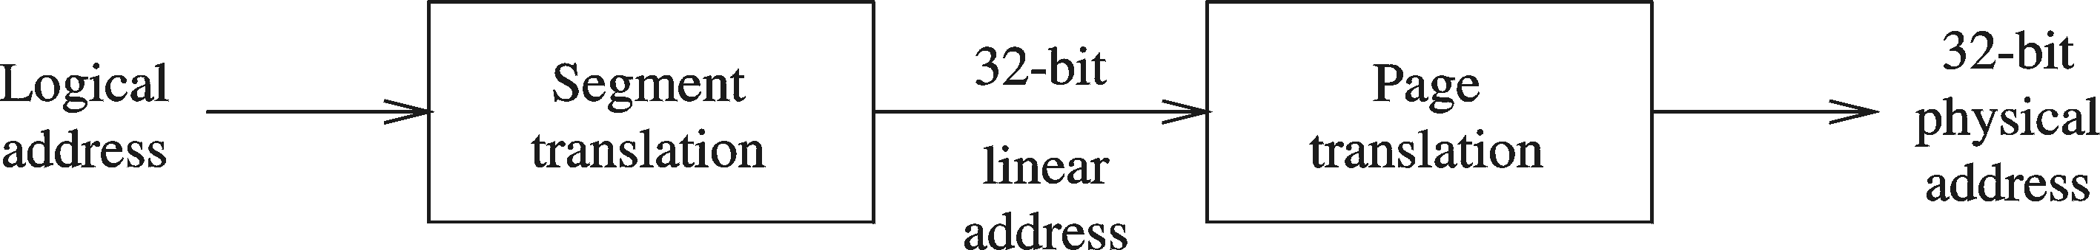
Protected Mode Architecture
Logical address consists of
16-bit segment selector (CS, SS, DS, ES, FS, GS)
32-bit offset (EIP, ESP, EBP, ESI ,EDI, EAX, EBX, ECX, EDX)
Segment unit translates logical address to linear address
Using a segment descriptor table
Linear address is 32 bits (called also a virtual address)
Paging unit translates linear address to physical address
Using a page directory and a page table

Slide 46
Paging
Paging divides the linear address space into …
Fixed-sized blocks called pages, Intel IA-32 uses 4 KB pages
Operating system allocates main memory for pages
Pages can be spread all over main memory
Pages in main memory can belong to different programs
If main memory is full then pages are stored on the hard disk
OS has a Virtual Memory Manager (VMM)
Uses page tables to map the pages of each running program
Manages the loading and unloading of pages
As a program is running, CPU does address translation
Page fault: issued by CPU when page is not in memory

Slide 47
Thank you for listening

